Slide 1
Modern Concept of social work
Course Instructor: M. Aamir Latif

Slide 2
Agenda
Curative Concept
Rehabilitation
Prevention
Stress Management
Role of state

Slide 3
FUNCTIONS OF SOCIAL WORK

Slide 4
Functions are Concepts upon which the social service or social work is done.
Definition: Functions or Concepts of social services refers to the natural activities of social services or how the social work operates.
The Two Concepts:
Curative Concept
Rehabilitative Concepts

Slide 5
Curative Concept

Slide 6
Treatment that is meant to cure an illness or disease with the goal of a full recovery that includes an acceptable quality of life.
When you injure your leg or catch a disease from which you cannot walk, a hospital recommends you plaster the leg or provides you a permanent solution to that disease.
The services that are provided by the hospital is a social service and falls into Curative Functioning.
For cancer, a curative therapy approach depends on the cancer type and stage.

Slide 7
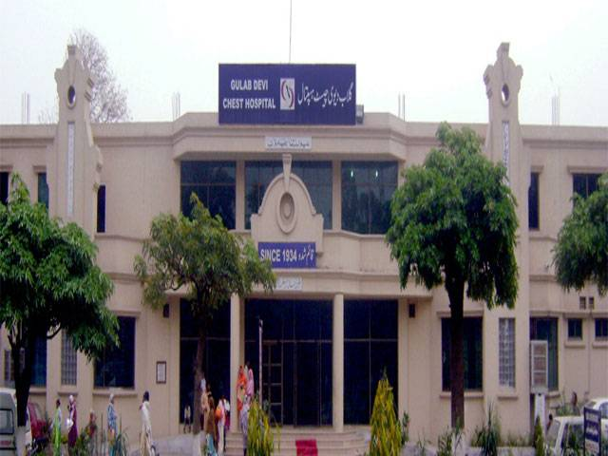
Definition: Curative Services mean medical assistance intended not only to reduce the pain but to cure that injury or disease.
For Example:
Gulab Devi is Semi-govt. hospital which provides free treatment for TB patients.

Slide 8
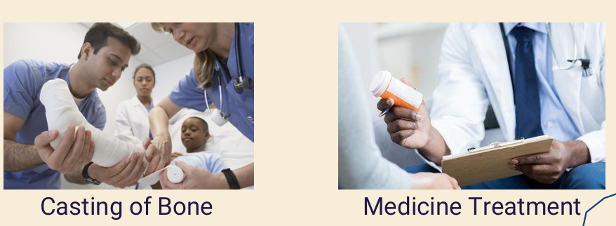

Slide 9
Services of Curative
The Services that are provided under curative functioning are
Medical and Health
Psychiatry
Child Guidance / Welfare
Handicapped / Disabled

Slide 10
Medical and Health
In medical & health comes:
Free Treatment for TB patients
Antibiotics for Bacterial infections
Cast for a broken bone
Dialysis treatment for kidney
Chemotherapy or radiation therapy for Cancer

Slide 11
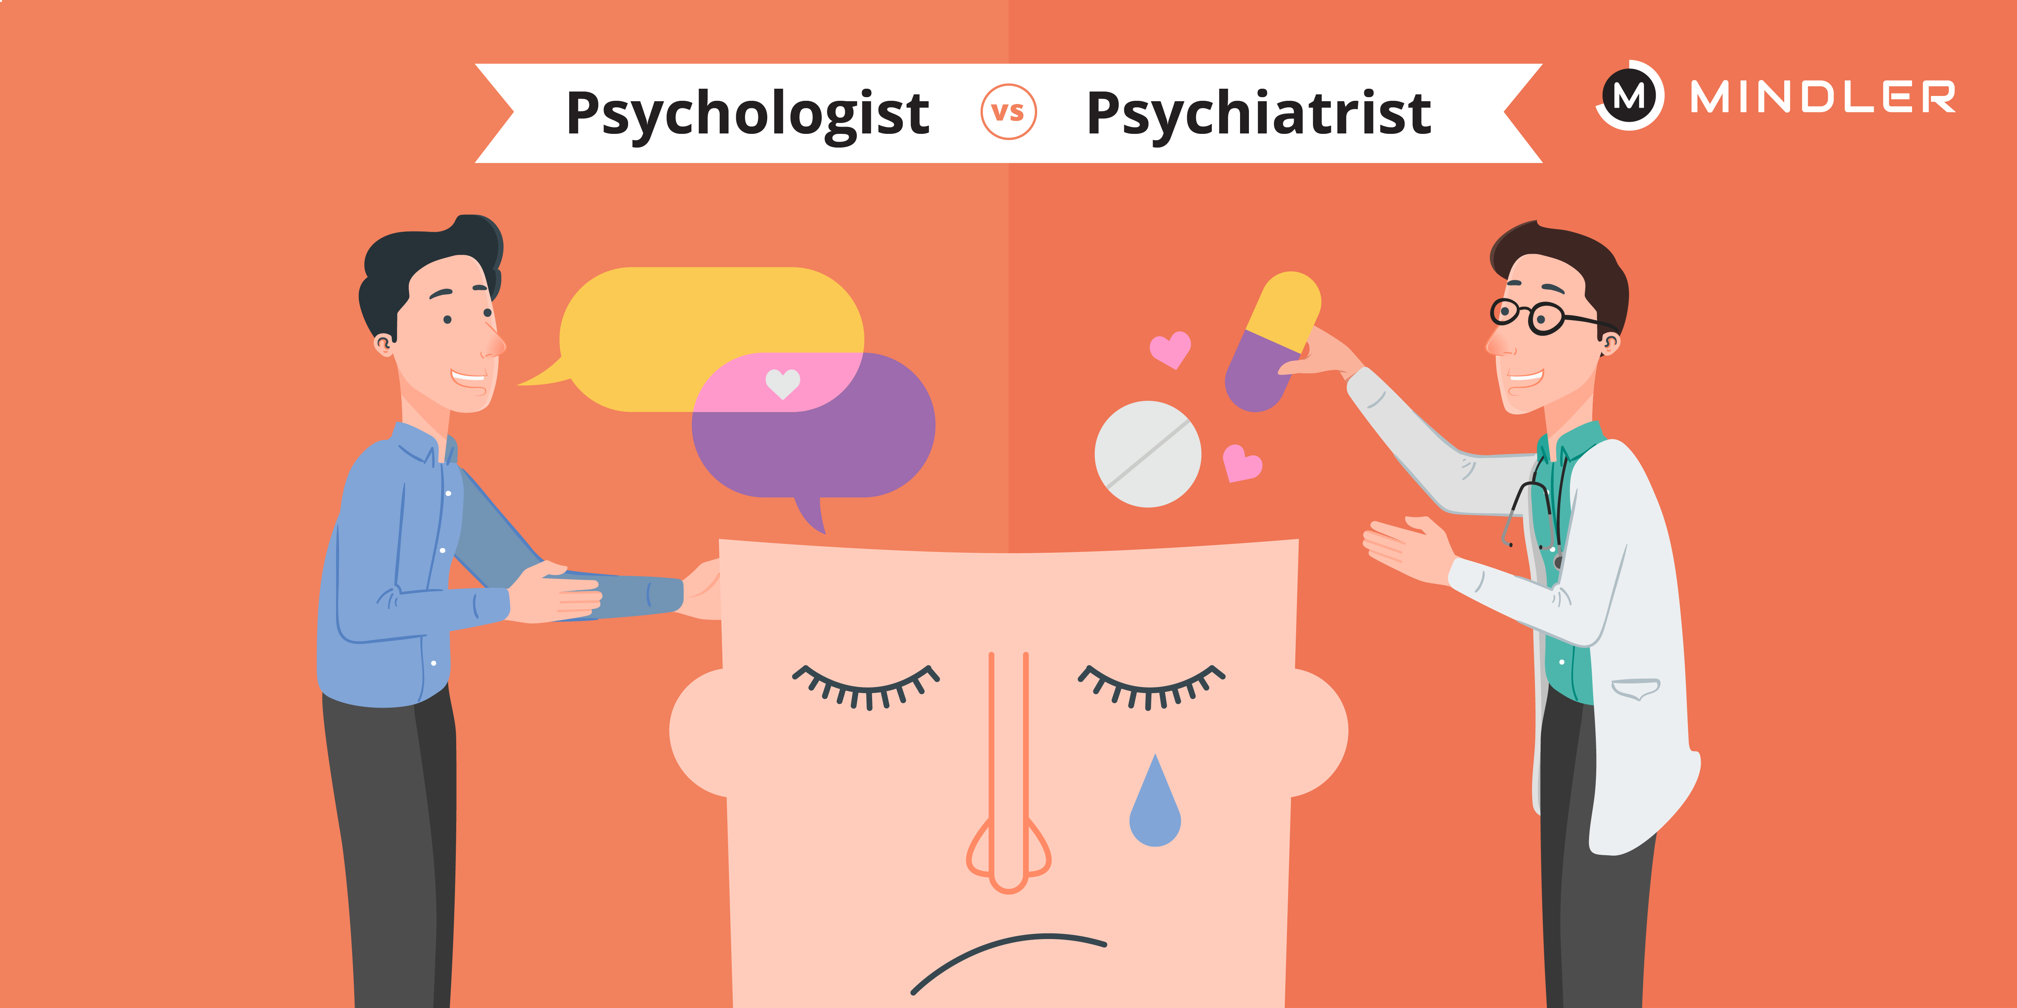
Psychiatry
A physician who deals with the diagnosis, and treatment of mental disorders:
Anxiety Depression Primary goal: relief of mental suffering and the improvement of mental well- being.

Slide 12

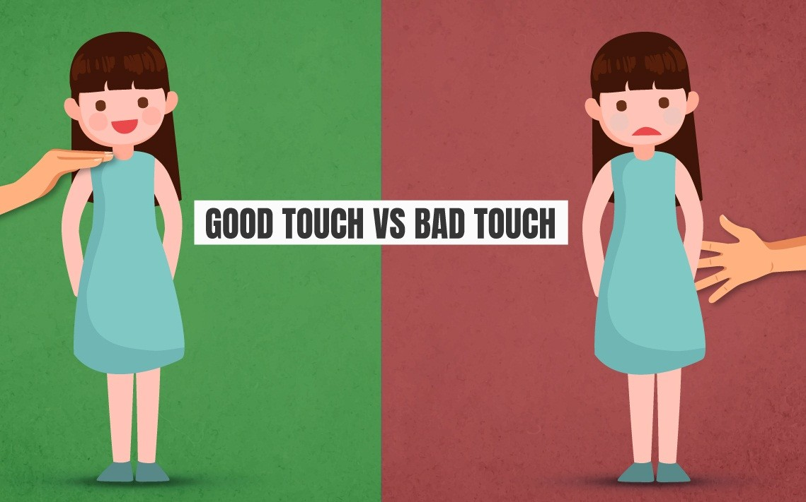
Child Guidance and Welfare:
This means studying children with emotional and behavioral problems so that trained professionals can help them.
Help them in:
Being Socially interactional
Reeducate them
Protect them from any danger or risk

Slide 13
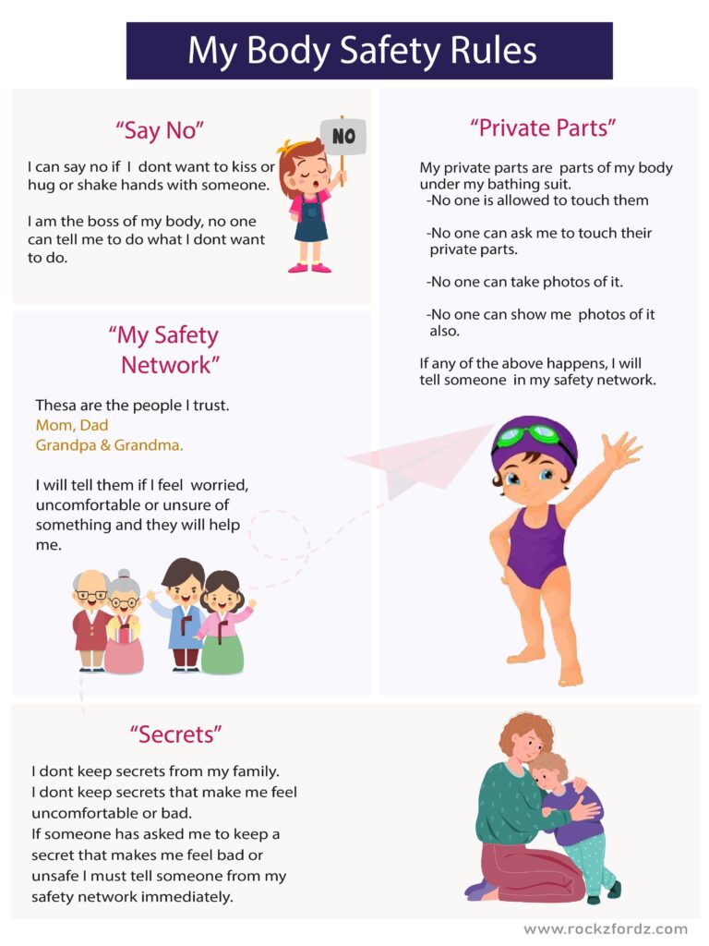

Slide 14
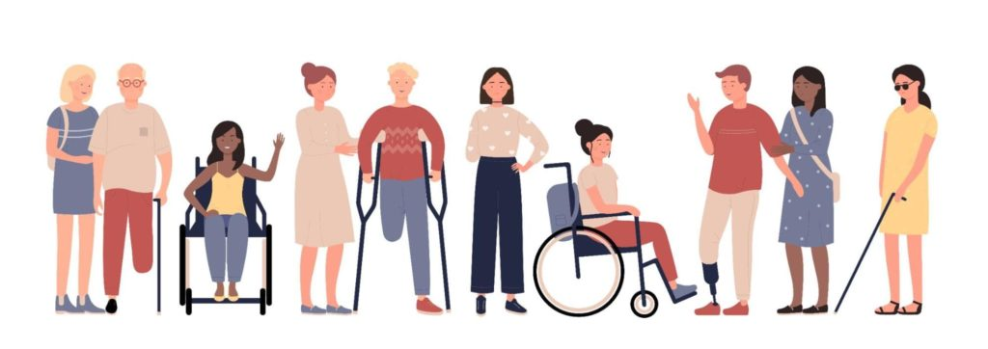
Handicapped or Disabled
Handicapped or disabled is a person having a condition that restricts their ability to function physically, mentally, and socially.
Help them;
Provide Assistance.
Provide the equipment that helps them with their disability.
Provide food to them. These people also need help to live healthy and good life.

Slide 15
Hospital That have Really Good Curative
Shaukat Khanum Memorial Cancer Hospital and Research Centre
Address: 7A ،،Khayaban-e-Firdousi, Block R3 Block R 3 M.A Johar Town, Lahore, Punjab Hours:
Open 24 hours Phone: (042) 35905000
Gulab Devi Chest Hospital
Address: Ferozepur Rd, Nishtar Town, Lahore, Punjab 54000 Hours:
Open 24 hours Phone: (042) 99230247

Slide 16
Rehabilitation

Slide 17
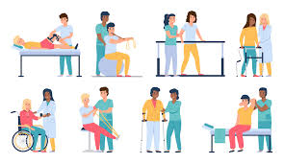
Definition: Rehabilitation means a plan to restore an individual’s former functions, and environmental status or to maximize the current functions.
This is where rehabilitation can help you move better, in maintaining your balance, maintain your posture, fix your mobility and help you avoid being hospitalized again.

Slide 18
After dealing with an injury or long-term a long-term illness it is common for people to experience difficulties in performing everyday tasks.
Long-term bed rest, inactivity, illness can affect your balance mobility energy, and much more.
For example:
A fractured bone was fixed by plaster casting, and the person got used to his life with the plaster after removing those plasters, He may face difficulties while walking.
Similarly, COVID-19 can weaken your immune system and your stamina.

Slide 19

Rehabilitative services

Slide 20
Some Of these are
Medical Evaluation
Counseling
Education
Employee Placing
Vocational Training

Slide 21
CBR (Community-Based Rehabilitation)
CBR is a system in which millions of disabled people have the right to lead a good life, have equal opportunities, have good medical care, and get a good education.
CBR focuses on the full participation and inclusion of persons with disabilities within every domain of their community. It empowers the persons with disabilities and supports them to overcome physical and sociological barriers.
There are special schools for disabled children.
In the field of computer science disabled person can do work if he’s not able to get up he can sit at home and do work like freelancing.

Slide 22
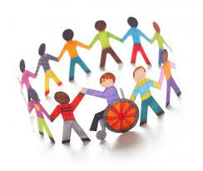
It is a process in which an individual’s health status includes a medical history and physical examination conducted by an authorized person.
For example: A patient will meet with the nurse and she will ask him about his medical history, his allergies, past surgeries, and immunizations after that Doctor will conduct a vital sign check, physical exam, or a visual exam.

Slide 23
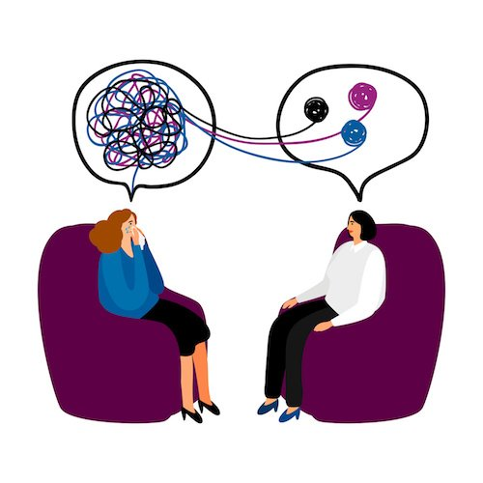
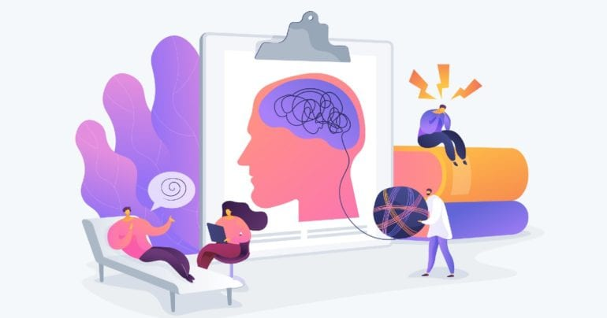
Medical counseling
It is a helping process in which the problems, needs, and feelings of a patient are enhanced or solved which is usually done by a psychologist.
A person with a mental disorder or any other health condition.

Slide 24
Vocational Training:
Vocational Training is made up of Programs that can help you acquire a skill or improve the skills for a particular job.
Vocational rehabilitation is a service that is designed to facilitate people with disabilities to enter into work I’ll get back to it.
National Training Center for Special Persons (NTCSP)
Address: Mangla Rd, G-9/2 G 9/2 G-9, Islamabad, Islamabad Capital Territory 44000
Hours: 9 pm-2 pm
Phone: (051) 9260182

Slide 25
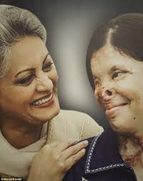
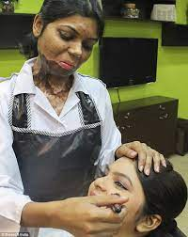
Depilex Smileagain Foundation, they are committed to provide acid attack survivors with not only medical care and assistance but also an opportunity to become productive, self-reliant members of society. Their vision extends beyond the immediate needs of the survivors and focuses on their long-term rehabilitation.

Slide 26
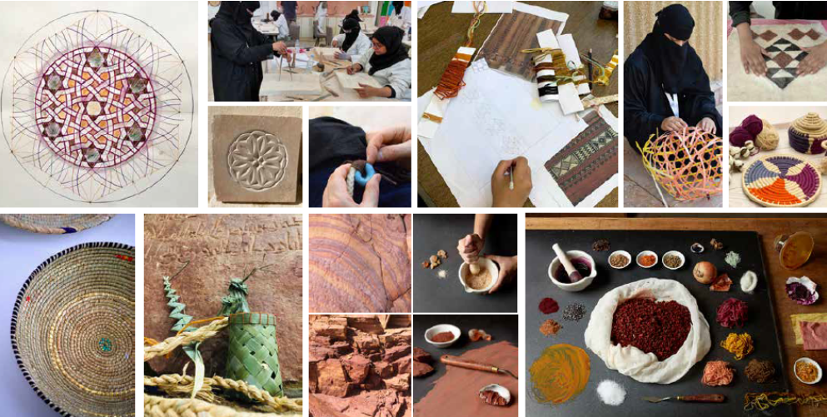

Slide 27
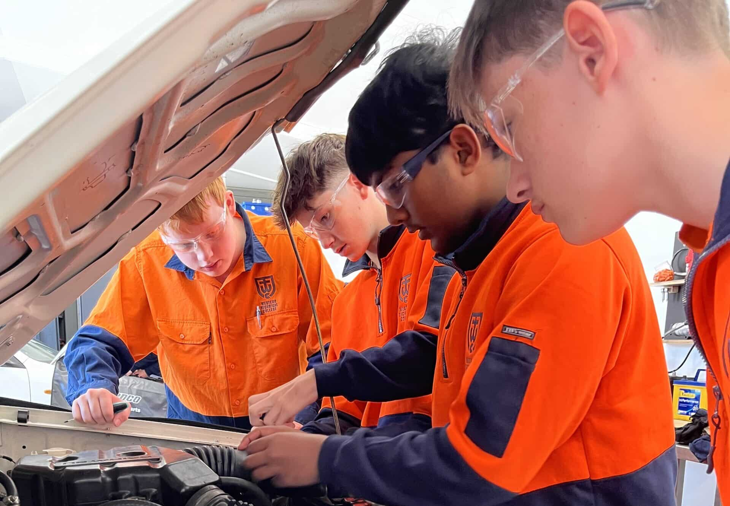

Slide 28
Rehabilitation Service Center
PSRD (Pakistan Society for the Rehabilitation of the Disabled)
Address: Galaxy Stop, The Pakistan Society For The Rehabilitaion of The Disabled, 111 Ferozepur Rd, Fazlia Colony, Lahore, Punjab
Hours: 8AM – 2pm
Phone: (042) 3742345

Slide 29
In the end, especially being Muslims, we must take care of our fellow Brothers and Sisters. Islam has strongly recommended the Social Service. It not only increases our good deeds but also makes our iman stronger and makes us better humans Not To forget Ihsan (Doing of Good). On the Day of Judgement, we all have to be responsible for our actions. DO good Have good.

Slide 30
Preventive Function

Slide 31
PREVENTIVE FUNCTION
Prevention – also called preventive health – means any action taken to keep people healthy and well, and prevent or avoid risk of poor health, illness, injury and early death.
Prevention aims to increase the likelihood that people will stay healthy and well for as long as possible.
Effective prevention decreases the risk of individuals experiencing a disease, condition or injury. It also supports people to effectively manage existing diseases or conditions, so their health does not worsen.
The Prevention Centre focuses on the prevention of chronic diseases and conditions.
Examples include immunization against disease, maintaining a healthy diet and exercise regimen, and avoiding smoking.

Slide 32
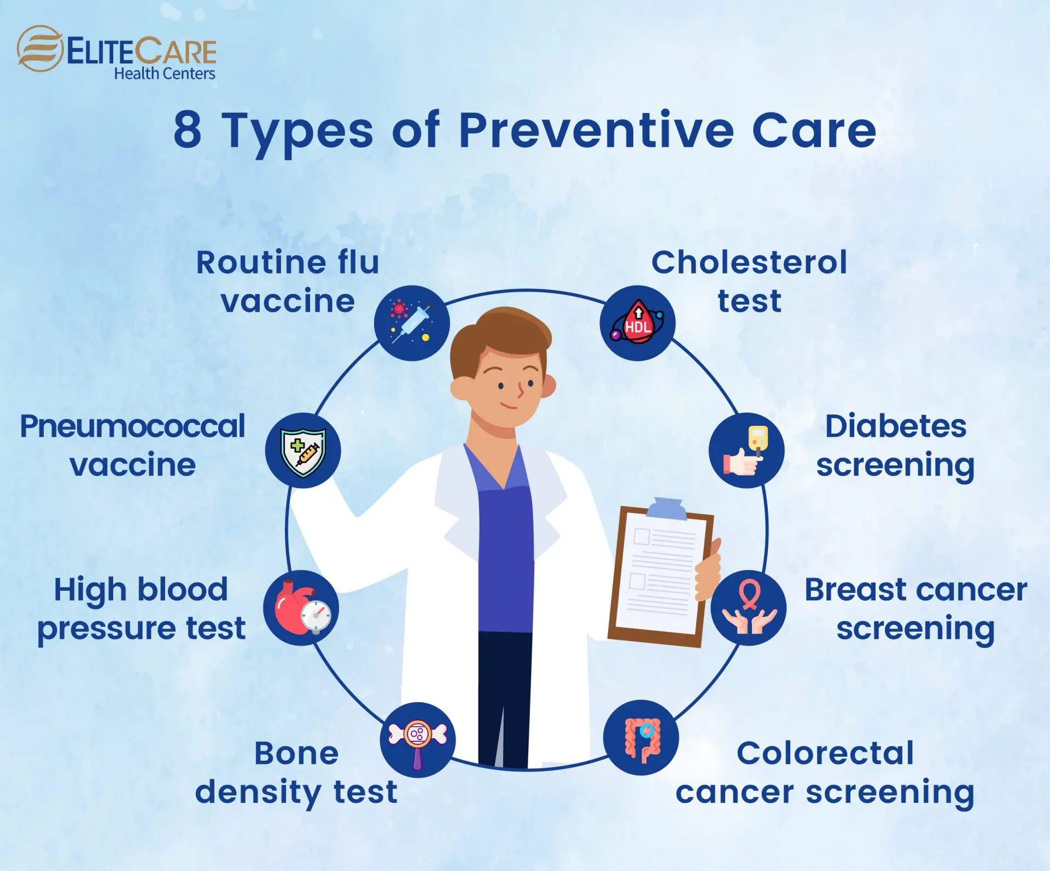

Slide 33

Stress Management

Slide 34
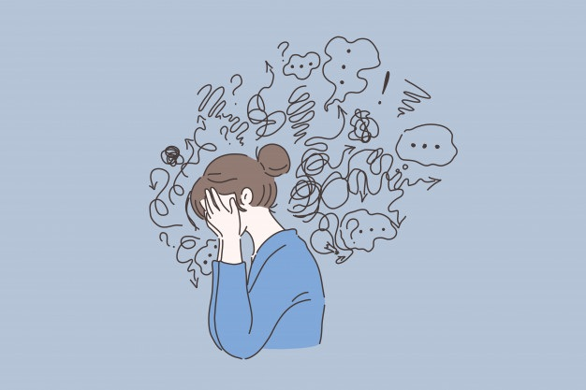
What is Stress?
Stress: Stress is the reaction people have to excessive pressures or other types of demand placed upon them. It arises when they worry that they can’t cope.
One may feel; worry, tense, tired, frightened, elated, depressed, anxious, anger etc.
Coping: The ability to maintain control, think rationally, and solve problems.

Slide 35
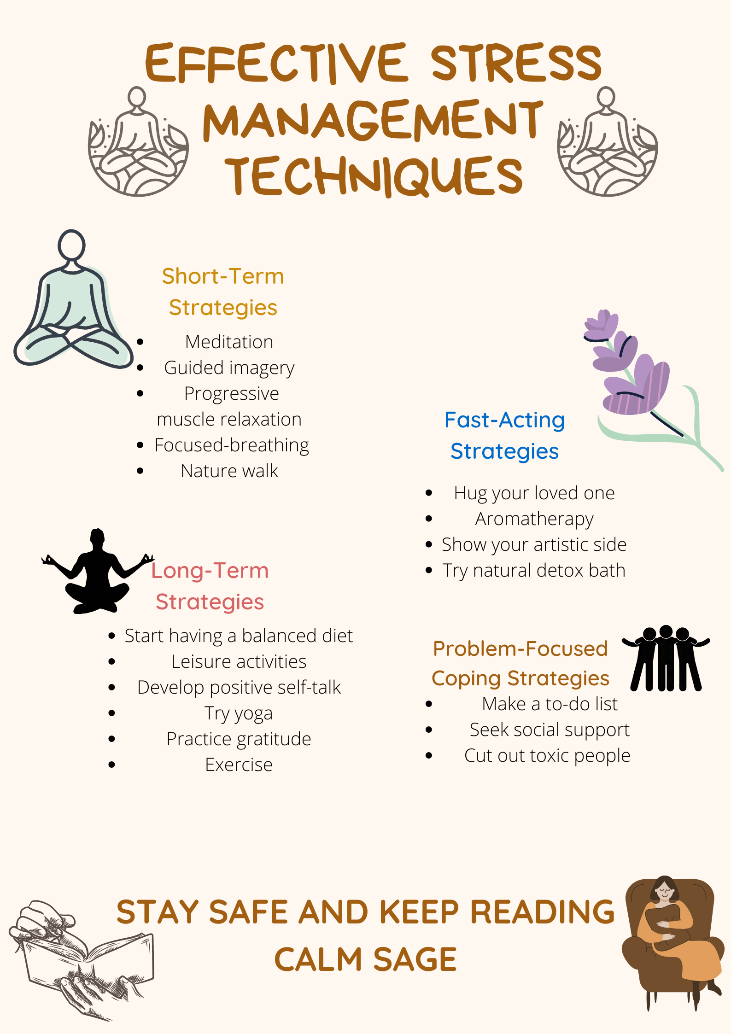

Slide 36
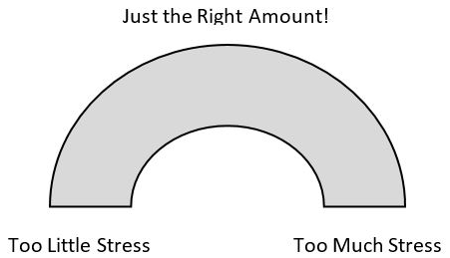
Is All Stress Bad?
Moderate levels of stress may actually improve performance and efficiency
Too little stress may result in boredom
Too much stress may cause an unproductive anxiety level

Slide 37
Causes
Academics: workload, challenging classes, packed schedule, studying.
Social obstacles: making friends, independence, balancing life.
Time management: organizing, deadlines, procrastination.
Financial difficulties: university expenses, living cost, food costs.
Other: sleep deprivation, jobs, unhealthy eating habits.

Slide 38
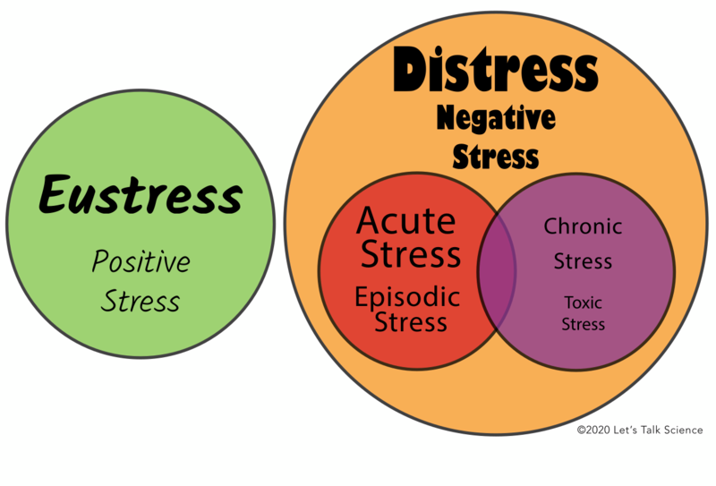
Types of stress
Negative & Positive Stress: Eustress: Manageable stress, can lead to growth and enhanced competence. Distress: Uncontrollable, prolonged, or overwhelming stress. It is destructive.

Slide 39
Types of Stressors
External (physical environment, social interactions, organizational, major life events, daily hassles)
Internal (negative self-talk, lifestyle choices)

Slide 40
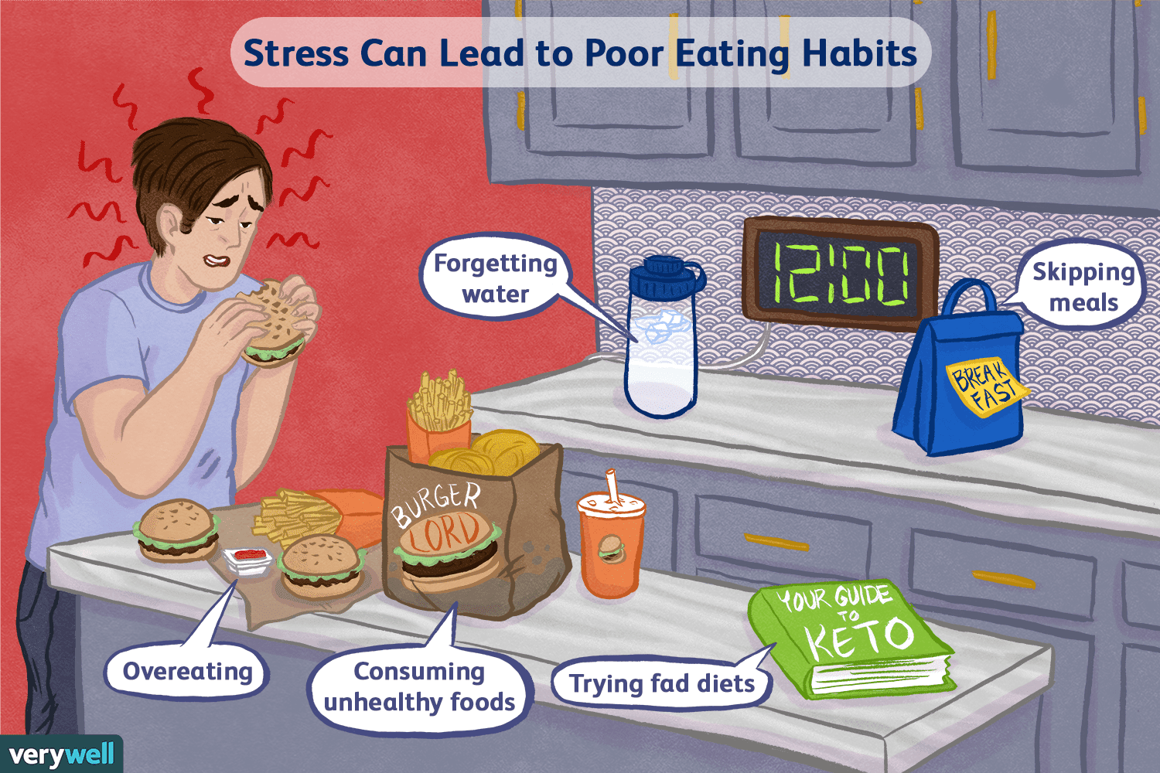

Slide 41
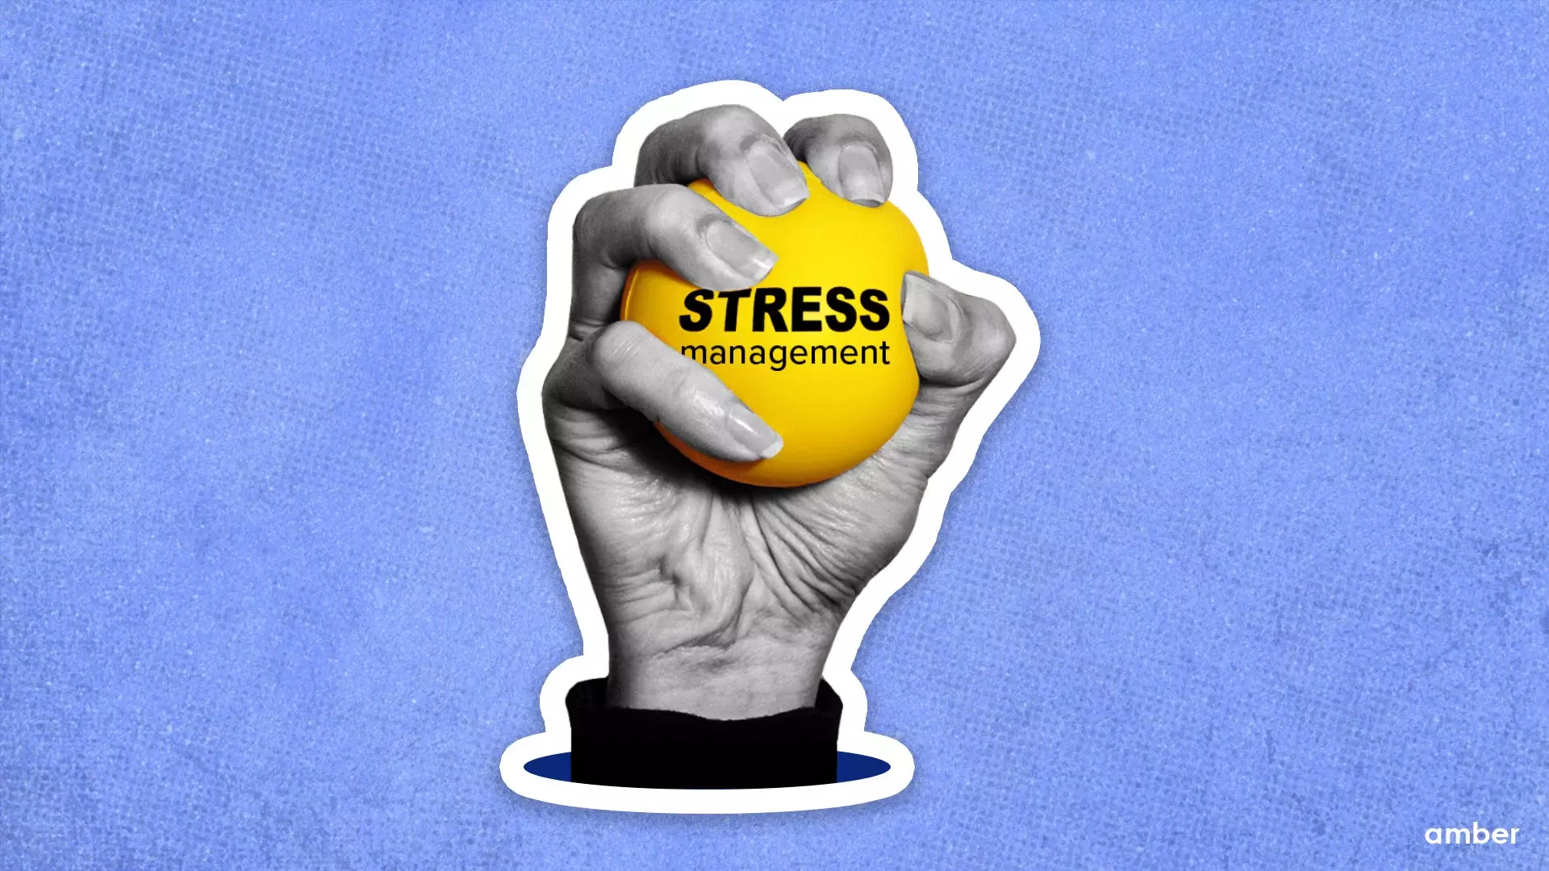

Slide 42
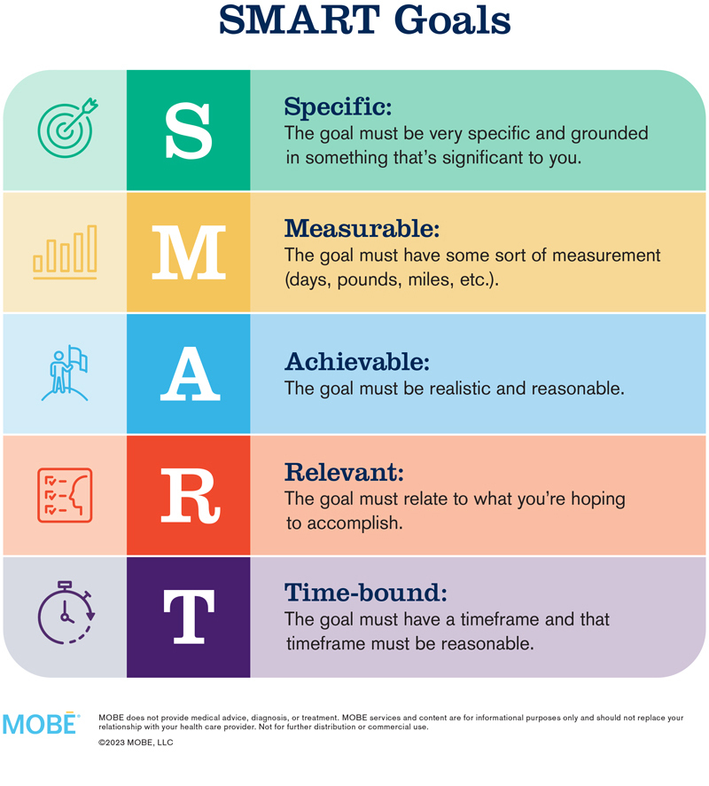
Time Management
SMART goals
To-do lists (Most to least important tasks) – Sense of accomplishment
Limit distractions – record, flight mode
Progress not perfection

Slide 43
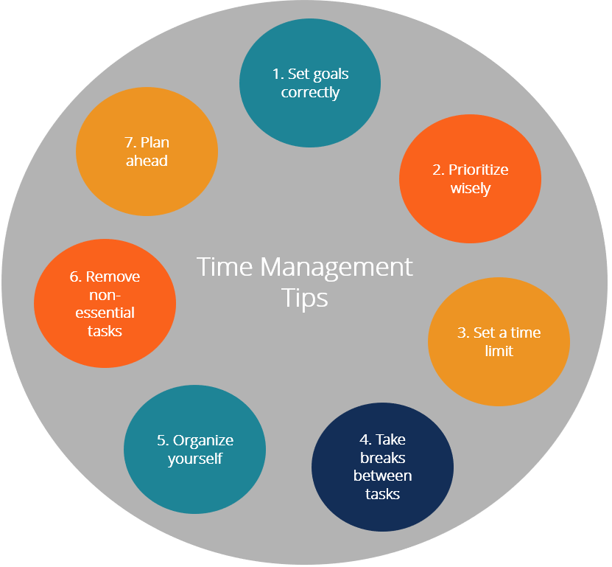
Time management

Slide 44
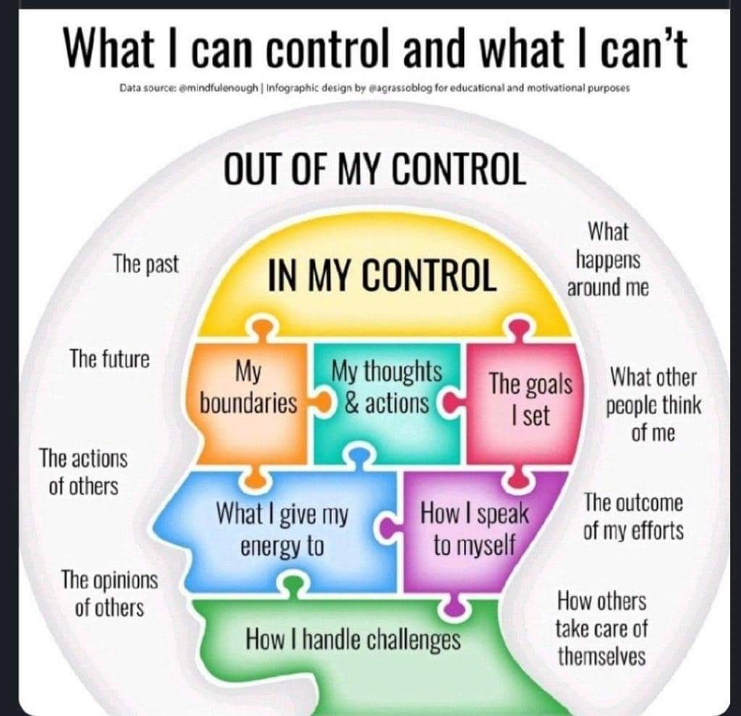

Slide 45

Repititive Prayers - Affirmations
Prayer is a very powerful tool that we have been blessed with.
O Lord! Help me in dealing with the stresses of life. Give me wisdom, strength, and patience to deal with them affectively.
Affirmation – It is a stressful situation and I am giving my best and that is what matters.

Slide 46
A positive affirmation is a statement that encourages positive thinking and self-empowerment. It helps to challenge negative thoughts and promote self-belief, resilience, and a positive mindset.
Self-Worth: "I am worthy of love and respect.“
Confidence: "I believe in my abilities and trust myself.“
Growth: "I embrace challenges as opportunities for growth.“
Health: "I choose to nourish my body and mind.“
Gratitude: "I am grateful for the abundance in my life."

Slide 47
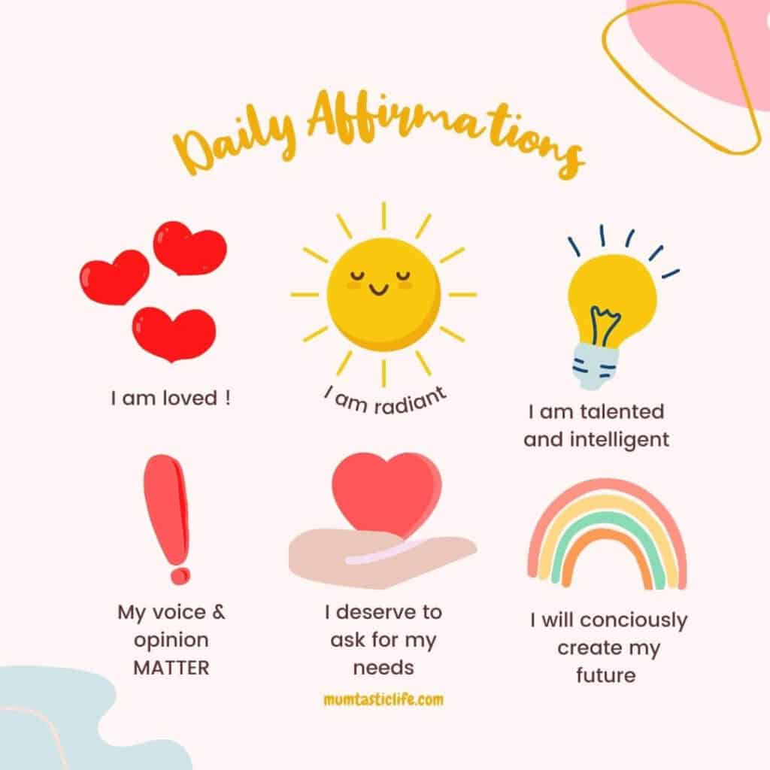

Slide 48
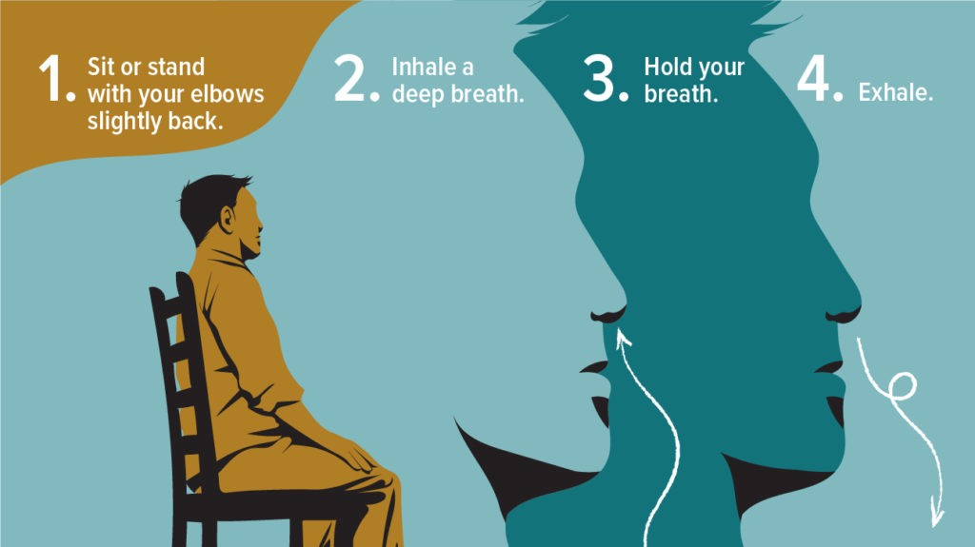
Deep Breathing

Slide 49

Self-care
Hobbies – Sports, reading, art, sitting under the sun and observing nature
Spend time with people you love
Taking bath is mandatory – once a day
Eat healthy food

Slide 50
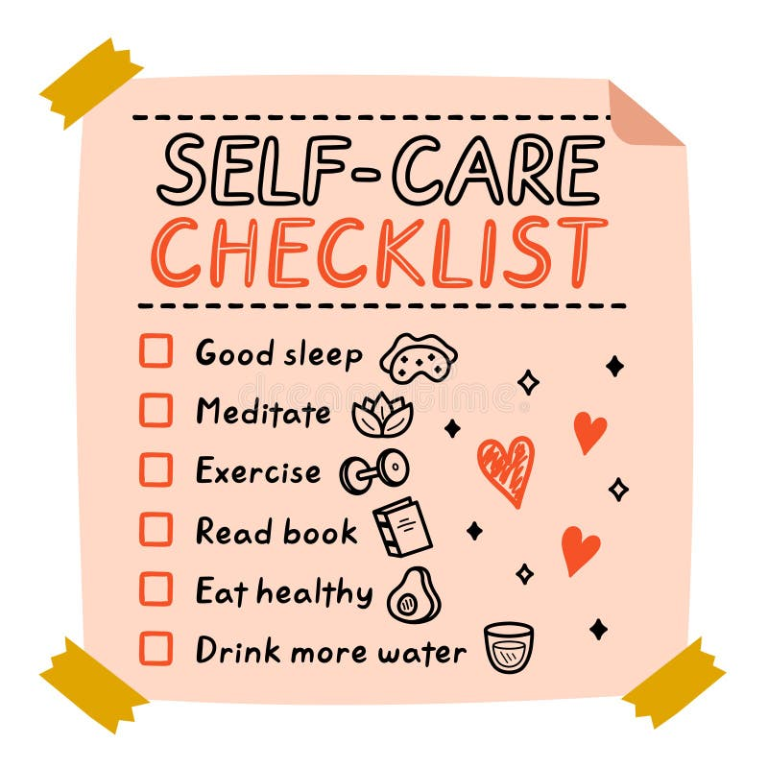

Slide 51
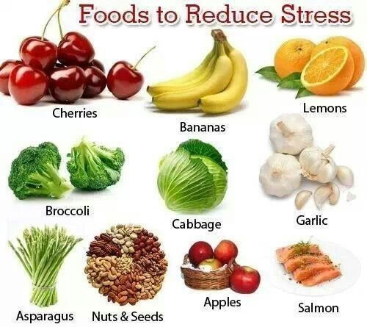

Slide 52
Role of state

Slide 53
Thankyou
ANY QUESTIONS????

